Slide 1

Hacking Environment Web Application
Detailed Developer Report

Slide 2
Security Status – Extremely Vulnerable
Hacker can steal all records in Internshal databases (SQLi)
Hacker can take control of complete server including View, Add, Edit, Delete files and folders (Shell Upload)
Hacker can change source code of application to host malware, phishing pages or even explicit content (Shell Upload)
Hacker can inject client side code into applications and trick users by changing how page looks to steal information or spoil the name of Internshala (XSS)
Hacker can extract mobile number of all customers using Userid (IDOR)

Slide 3
Vulnerability Statistics
Critical
17
Severe
15
Moderate
2
Low
2

Slide 4
Vulnerabilities:
No | Severity | Vulnerability | Count
1 | Critical | SQL Injection | 8
2 | Critical | Access to sales dashboard | 1
3 | Critical | Access to admin panel | 1
4 | Critical | Account takeover via OTP Bypass | 2
5 | Critical | Unauthorized Access To Customer Details | 5
6 | Severe | Reflected cross site scripting | 3
7 | Moderate | Directory Listing of Configuration Files | 2
8 | Low | Information disclosure due to Apache Default Pages | 2

Slide 5
1. SQL Injection
SQL Injection (Critical) | Below mentioned URL in the Hogwarts House Details module is vulnerable to SQL injection attack Affected URL : http://url.com/hogwarts/house_details.php?house=HERE Affected Parameters : house (GET parameter) Payload: house=gryffindor’

Slide 6
1. SQL Injection
SQL Injection (Critical) | Here are other similar SQLi in the application Affected URL : http://url.com/sql3.php (ID GET parameter) http://url.com/sql4.php (jkl POST parameter) http://url.com/sql5.php (pqr 5 GET parameter) http://url.com/sql6.php (abcd cookie paramter) http://url.com/sql7.php (User-agent Header) http://url.com/sql8.php (xyz POST parameter)

Slide 7
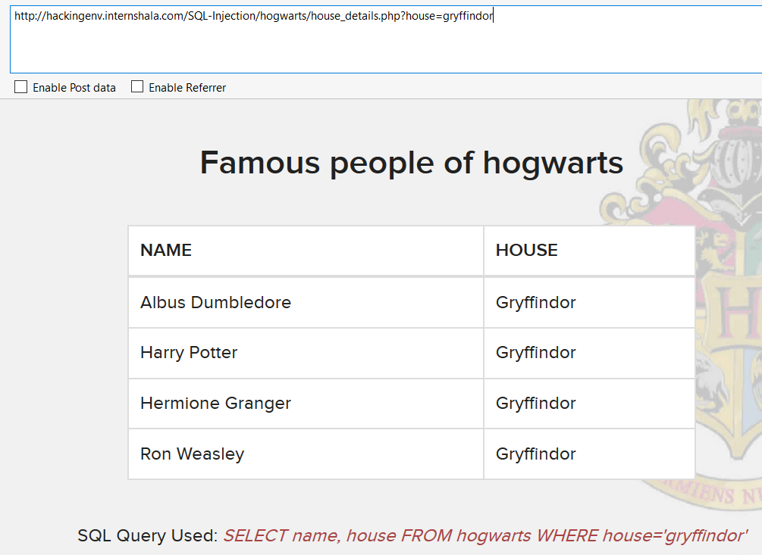
Observation
Navigate to Houses page where you will see list of houses. Click any one like Gryffindor. You will see famous people of that house in a table. Notice the GET parameter house in the URL:

Slide 8
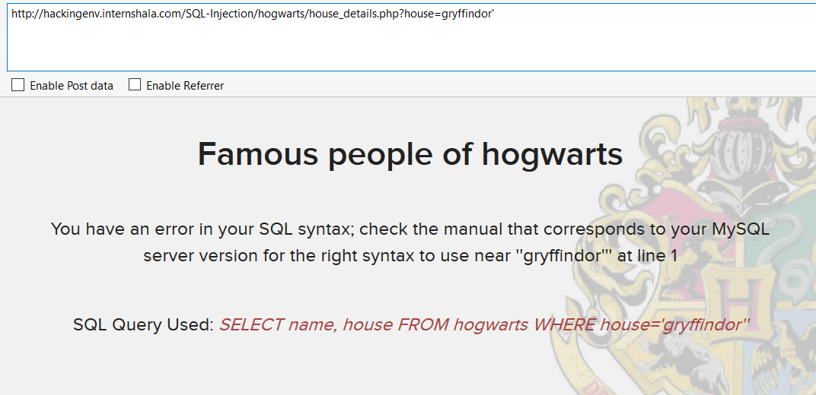
Observation
We apply single quote in house parameter: house_details.php?house=Gryffindor’ and we get complete MySQL error:

Slide 9
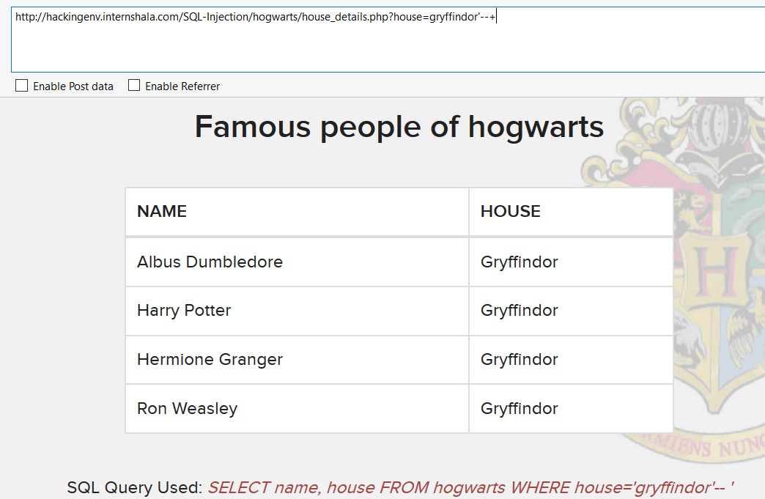
Observation
We then put --+ : house_details.php?house=Gryffindor’--+ and we error is removed confirming SQL injection:

Slide 10
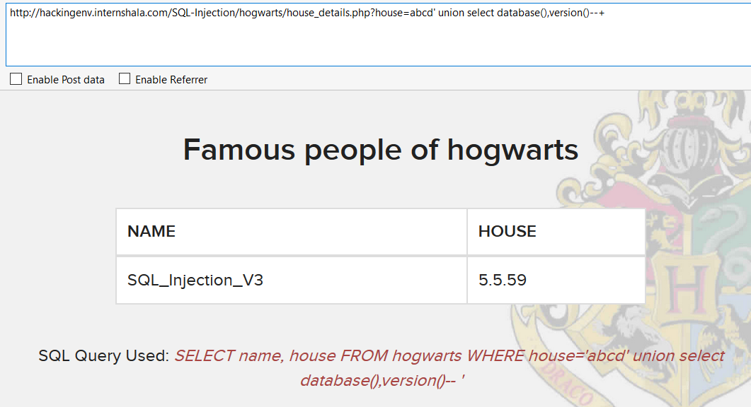
Proof of Concept (PoC)
Attacker can execute SQL commands as shown below. Here we have used the payload below to extract the database name and MySQL version information: house=abcd’ union select database(),version()--+

Slide 11
PoC – Attacker can dump arbitrary data
No of databases: 3
Information_schema
SQL_Injection_V3
Test
No of tables in SQL_Injection_V3: 2
Hogwarts
Users

Slide 12
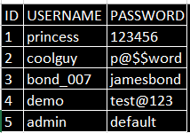
Business Impact – Extremely High
Using this vulnerability, attacker can execute arbitrary SQL commands on Internshala server and gain complete access to internal databases along with all customer data inside it.
Below is the screenshot of users table which shows user credentials being leaked that too in plain text without any hashing/encryption.
Attacker can use this information to login to admin panels and gain complete admin level access to the website which could lead to complete compromise of the server and all other servers connected to it.

Slide 13
1. SQL Injection
SQL Injection (Critical) | Below mentioned URL in the Petunia Flowers – Flower Search module is vulnerable to SQL injection attack Affected URL : http://url.com/petunia/flowerSearch.php Affected Parameters : Flower (POST parameter) Payload: flower=rose’

Slide 14
PoC – Attacker can dump arbitrary data
No of databases: 3
Information_schema
SQL_Injection_V3
Test
No of tables in SQL_Injection_V3: 2
Hogwarts
Users
Critical Table: Users

Slide 15
Recommendation
Take the following precautions to avoid exploitation of SQL injections:
Whitelist User Input: Whitelist all user input for expected data only. For example if you are expecting a flower name, limit it to alphabets only upto 20 characters in length. If you are expecting some ID, restrict it to numbers only
Prepared Statements: Use SQL prepared statements available in all web development languages and frameworks to avoid attacker being able to modify SQL query
Character encoding: If you are taking input that requires you to accept special characters, encode it. Example. Convert all ‘ to \’ , “ to \”, \ to \\. It is also suggested to follow a standard encoding for all special characters such has HTML encoding, URL encoding etc
Do not store passwords in plain text. Convert them to hashes using SHA1 SHA256 Blowfish etc
Do not run Database Service as admin/root user
Disable/remove default accounts, passwords and databases
Assign each Database user only the required permissions and not all permissions

Slide 16
References
https://www.owasp.org/index.php/SQL_Injection
https://en.wikipedia.org/wiki/SQL_injection

Slide 17
2. Access to Sales Dashboard
Access to Sales Dashboard (Critical) | The Sales dashboard at the below mentioned URL has default/weak password allowing complete admin access Affected URL : http://url.com/salesdashboard.php Affected Parameters : Username, password (POST parameters) Payload: Username=admin password=sales@123

Slide 18
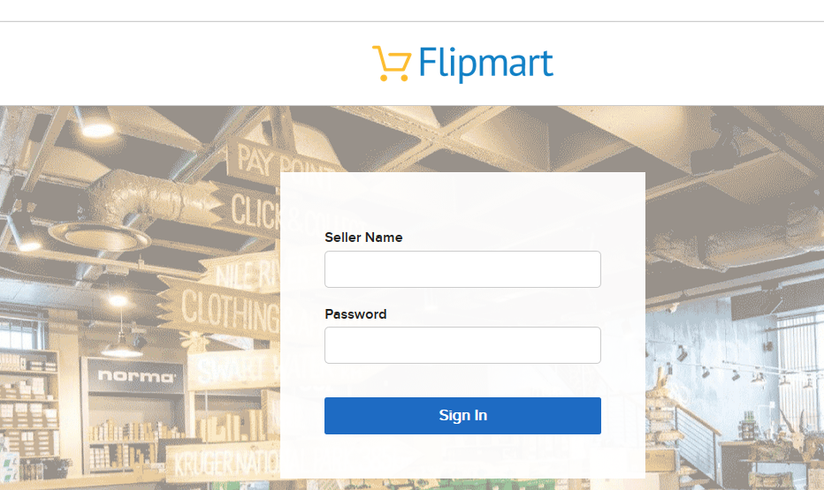
Observation
Navigate to http://url.com/salesdashboard.php You will see sales admin login page

Slide 19
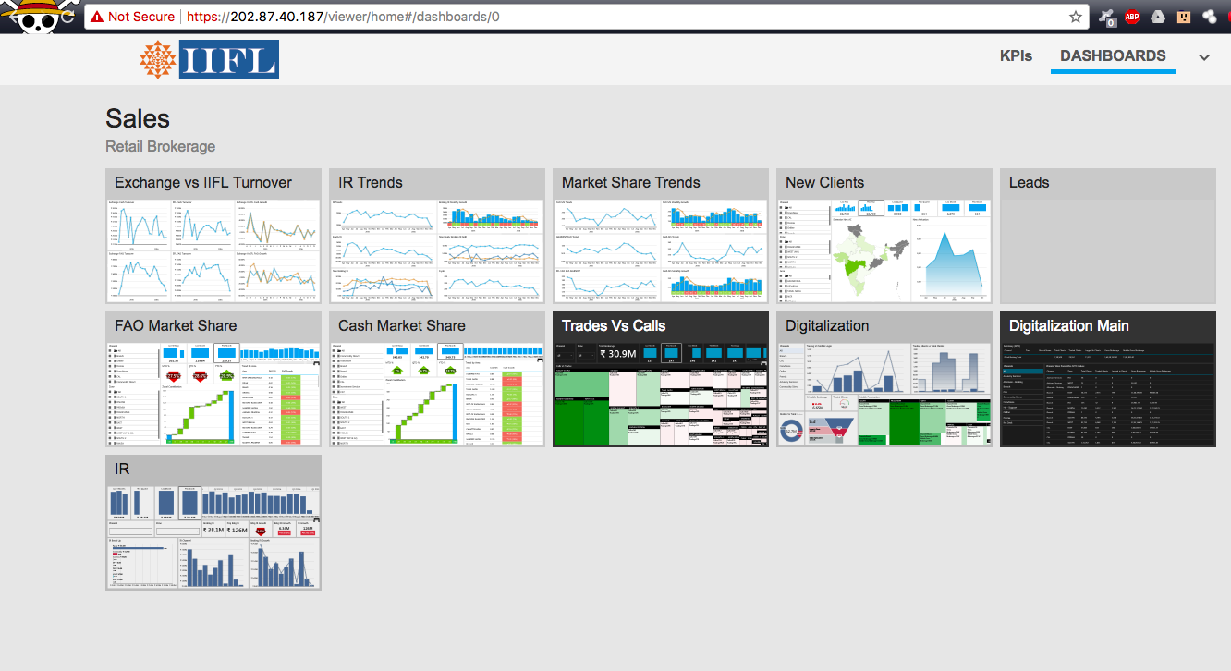
Observation
Enter username: admin & password: sales@123. You will get loggedin to the admin panel

Slide 20
Business Impact – Extremely High
A malicious user can access the Sales Dashboard which discloses many critical
information of organization including:
Sales Trends
Client information
Leads information
Sales Calandar information
Income and revenue information
And much more…

Slide 21
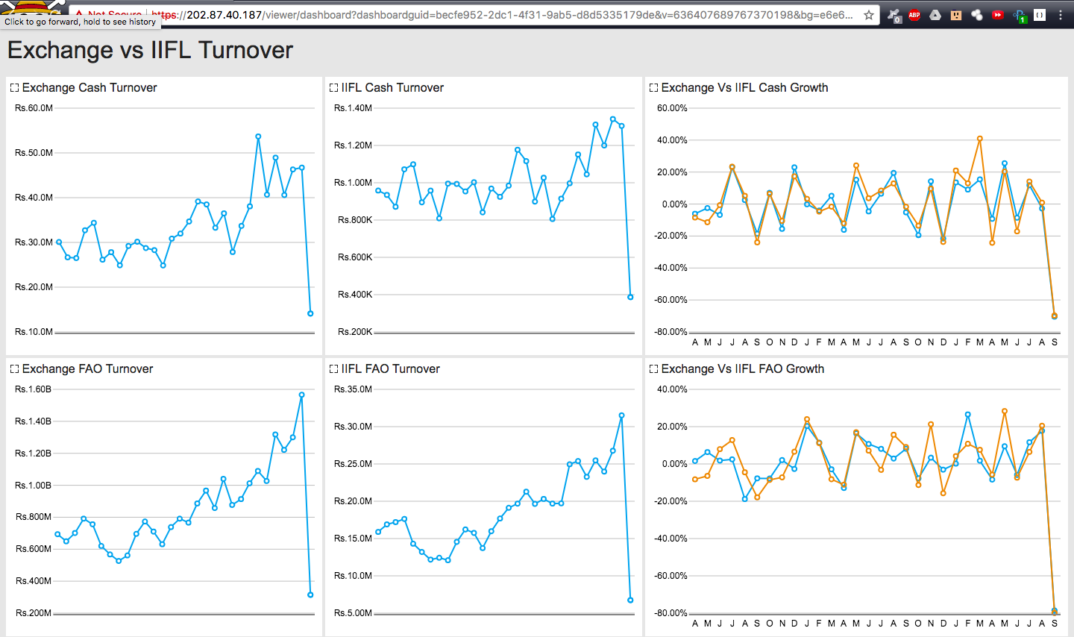
POC

Slide 22
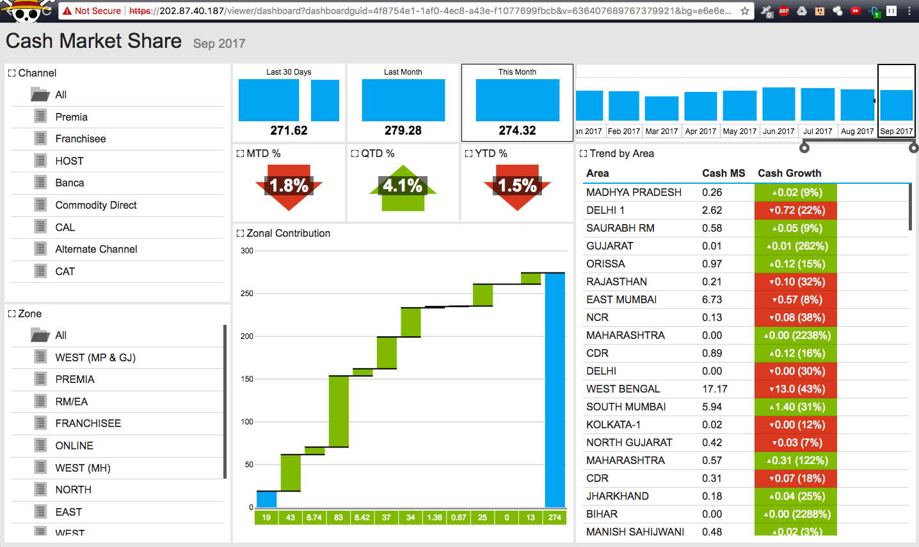
POC

Slide 23
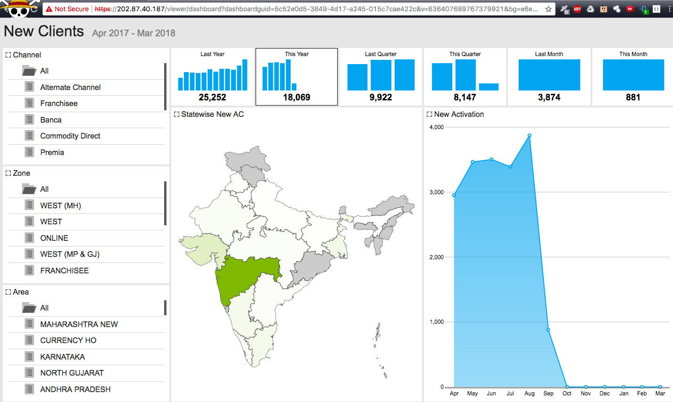
POC

Slide 24
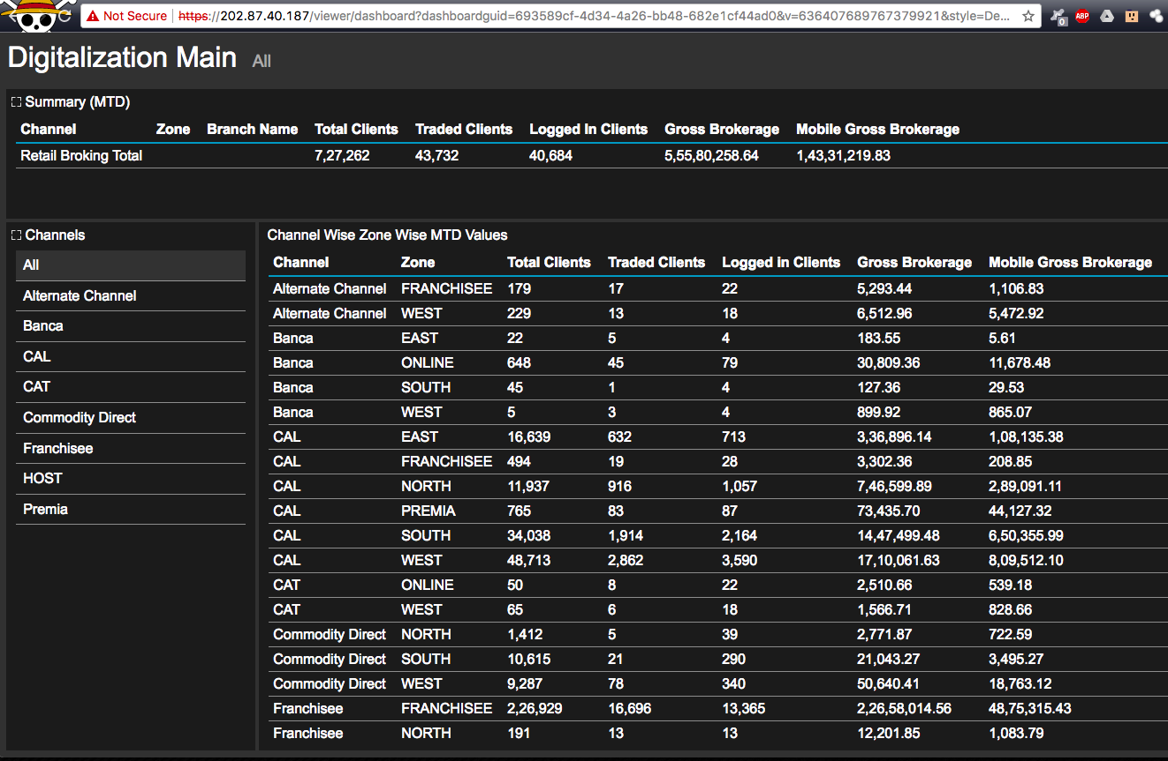
POC

Slide 25
Recommendation
Take the following precautions:
Use a strong password 8 character or more in length with alphanumerics and symbols
It should not contain personal/guessable information
Do not reuse passwords
Disable default accounts and users
Change all passwords to strong unique passwords
References:
https://www.owasp.org/index.php/Testing_for_weak_password_change_or_reset_functionalities_(OTG-AUTHN-009)
https://www.owasp.org/index.php/Default_Passwords
https://www.us-cert.gov/ncas/alerts/TA13-175A

Slide 26
3. Account Takeover Using OTP Bypass
Account Takeover Using OTP Bypass (Critical) | The below mentioned login page allows login via OTP which can be bruteforced Affected URL : http://url.com/login_via_OTP.php Affected Parameters : OTP (POST parameters)

Slide 27
3. Account Takeover Using OTP Bypass
Account Takeover Using OTP Bypass (Critical) | Similar issue is observed on the below mentioned login pages too Affected URL : http://url.com/admin/login_via_OTP.php Affected Parameters : code (POST parameters)

Slide 28
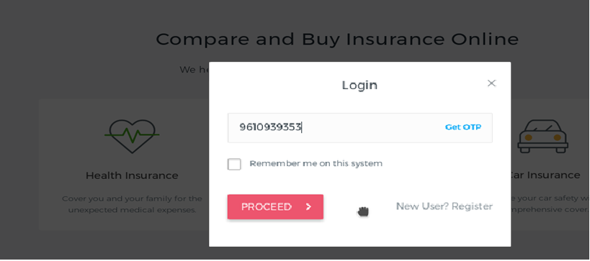
Observation
Navigate to http://url.com/login_via_OTP.php You will see user login page via OTP. Enter victim’s mobile number while capturing requests in a local proxy and click Get OTP

Slide 29
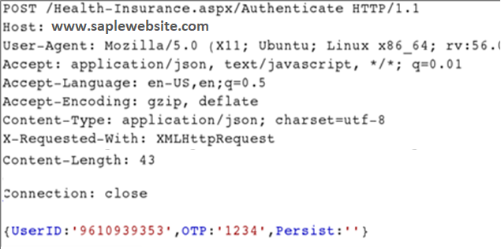
Observation
Following request will be generated containing OTP parameter.

Slide 30
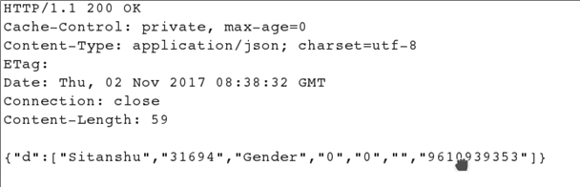
Observation
We shoot the request with all possible combinations of 4 Digit OTPs and upon a successful hit, we get a response containing user details. We can use the same OTP then to login.

Slide 31
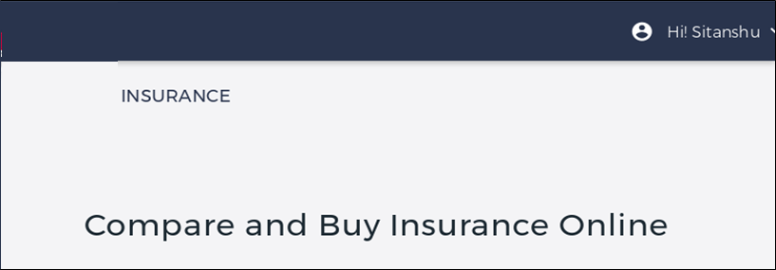
Business Impact – Extremely High
A malicious hacker can gain complete access to any account just by knowing the registered phone number. This leads to complete compromise of personal user data of every customer.
Attacker once logs in can then carry out actions on behalf of the victim which could lead to serious financial loss to him/her.

Slide 32
Recommendation
Take the following precautions:
Use proper ratelimiting checks on the no of OTP checking and Generation requests
Implement anti-bot measures such as ReCAPTCHA after multiple incorrect attempts
OTP should expire after certain amount of time like 2 minutes
OTP should be atleast 6 digit and alpha numeric for more security
References:
https://www.owasp.org/index.php/Testing_Multiple_Factors_Authentication_(OWASP-AT-009)
https://www.owasp.org/index.php/Blocking_Brute_Force_Attacks

Slide 33
4. Unauthorised Access to Customer Details
Unauthorised Access to Customer Details (Critical) | The Show My Bill module suffers from an Insecure Direct Object Reference (IDOR) that allows attacker get access to anyones Bill details Affected URL : http://hackingenv.internshala.com/Insecure-Direct-Object-Reference/GET-Based-IDOR-in-URL-Variant-1/bill.php Affected Parameters : user_id (GET parameters)

Slide 34
4. Unauthorised Access to Customer Details
Unauthorised Access to Customer Details (Critical) | Similar issue is found on below modules too Affected URL : http://url/invoice.php Affected Parameters : invoice_id (GET parameter) Affected URL : http://url/call_history.php Affected Parameters : mobile_no (POST parameter) Affected URL : http://url/recharge.php Affected Parameters : from_accountno (POST parameter) Affected URL : http://url/sms_history.php Affected Parameters : mobile_no(GET parameter)

Slide 35
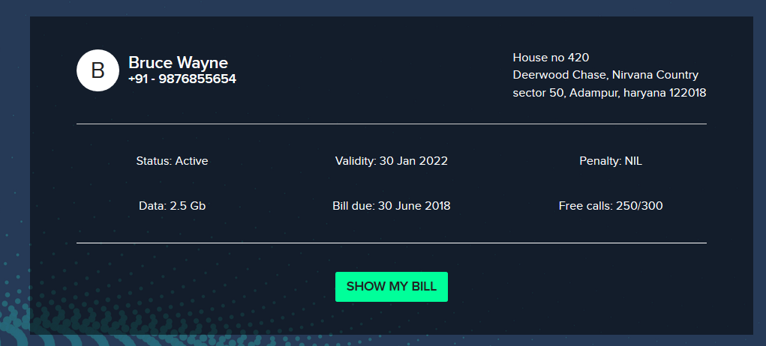
Observation
Login to your account and navigate to Bill page on http://hackingenv.internshala.com/Insecure-Direct-Object-Reference/GET-Based-IDOR-in-URL-Variant-1/ and click on Show My Bill button

Slide 36
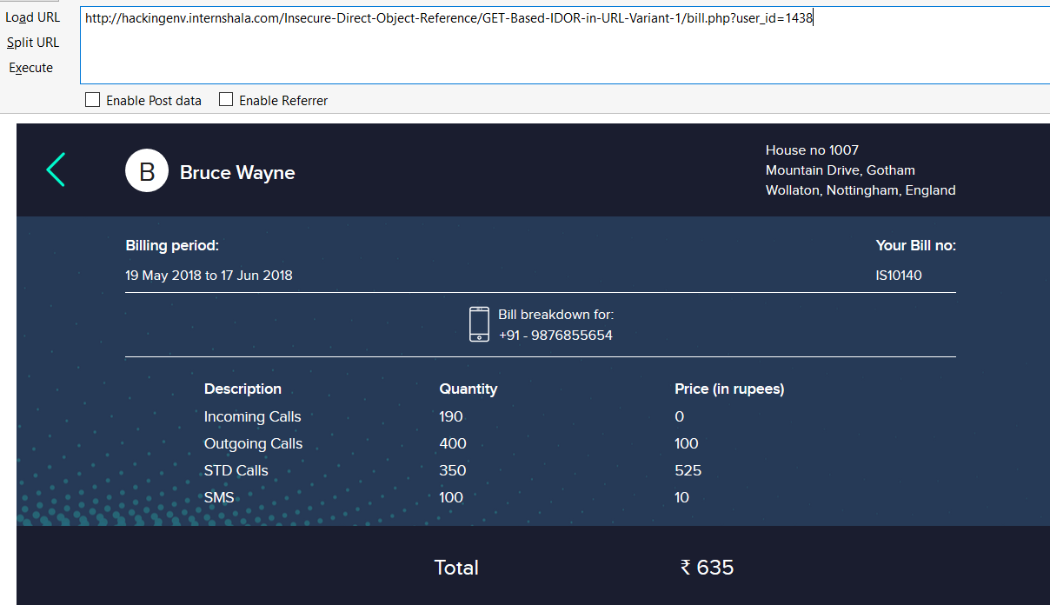
Observation
Your bill will be shown to you like below. Notice the URL: http://hackingenv.internshala.com/Insecure-Direct-Object-Reference/GET-Based-IDOR-in-URL-Variant-1/bill.php?user_id=1438
It contains user_id of our user and we get bill details of our user’s mobile number: 9876855654

Slide 37
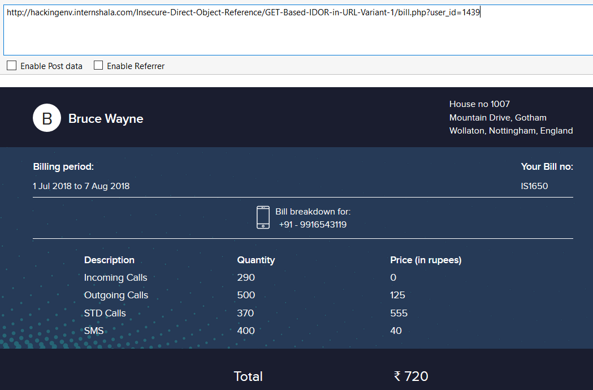
Observation
We change this user_id from 1438 to 1439 and we get bill information of a different user with mobile number: 9976543119

Slide 38
Business Impact – Extremely High
A malicious hacker can read bill information of any user just by knowing the User ID. This discloses critical billing information of users including:
Mobile Number
Bill Number
Billing Period
Bill Amount and Breakdown
This can be used by malicious hackers to carry out targeted phishing attacks on the users and the information can also be sold to competitors/blackmarket.
More over, as there is no ratelimiting checks, attacker can bruteforce the user_id for all possible values and get bill information of each and every user of the organization resulting is a massive information leakage.
Other IDORs on the application are leaking much more information including Payment details, call history and even allow attacker to recharge his mobile number deducting money from any one else’s account which can be used to steal money from users.
As a PoC, Bill details of 100 users are dumped in the attached excel file below:

Slide 39
Recommendation
Take the following precautions:
Implement proper authentication and authorisation checks to make sure that the user has permission to the data he/she is requesting
Use proper ratelimiting checks on the number of request comes from a single user in a small amount of time
Make sure each user can only see his/her data only.
References:
https://www.owasp.org/index.php/Insecure_Configuration_Management
https://www.owasp.org/index.php/Top_10_2013-A4-Insecure_Direct_Object_References

Slide 40
5. Reflected Cross Site Scripting (XSS)
Reflected Cross Site Scripting (Severe) | Below mentioned parameters are vulnerable to reflected XSS Affected URL : hackingenv.internshala.com/Cross-Site-Scripting/Temporary-XSS-Variant-1/hello.php Affected Parameters : user_name(GET parameters) Payload: <script>alert(1)</script>

Slide 41
5. Reflected Cross Site Scripting (XSS)
Reflected Cross Site Scripting (Severe) | Similar issue is found on below modules too Affected URL : http://hackingenv.internshala.com/Cross-Site-Scripting/Temporary-XSS-Variant-2/xss/testing* Affected Parameters : URL – anything after testing Payload: <body onload=alert(1)>
 | Affected URL : http://hackingenv.internshala.com/Cross-Site-Scripting/Temporary-XSS-Variant-4/ Affected Parameters : url (POST parameters) Payload: " onload="alert(1)

Slide 42
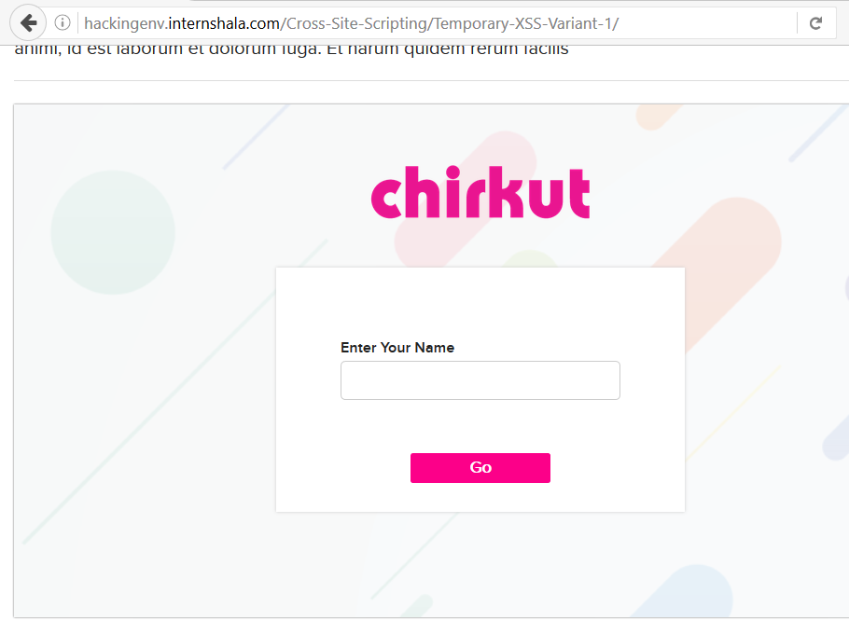
Observation
Navigate to hackingenv.internshala.com/Cross-Site-Scripting/Temporary-XSS-Variant-1/hello.php
You will see a field to enter some text

Slide 43
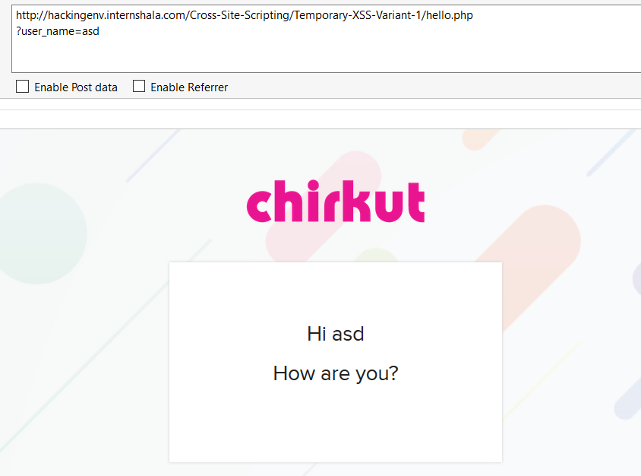
Observation
Enter any text and click the button, you will see it reflected in the next page and value will be in GET parameter user_name

Slide 44
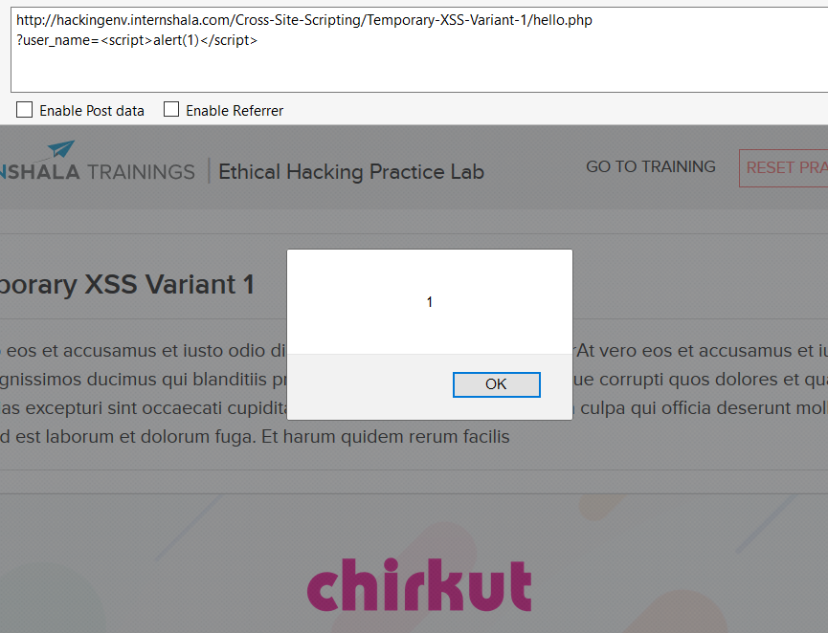
Observation
Put the payload instead of asd: <script>alert(1)</script>
As you can see we executed custom JS causing popup

Slide 45
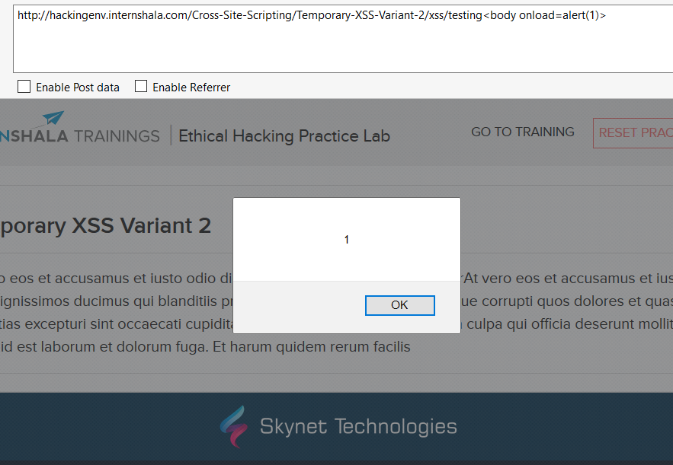
PoC

Slide 46
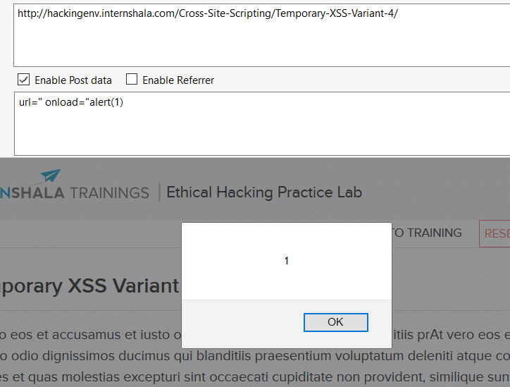
PoC

Slide 47
Business Impact – High
As attacker can inject arbitrary HTML CSS and JS via the URL, attacker can put any content on the page like phishing pages, install malware on victim’s device and even host explicit content that could compromise the reputation of the organization
All attacker needs to do is send the link with the payload to the victim and victim would see hacker controlled content on the website. As the user trusts the website, he/she will trust the content.

Slide 48
Recommendation
Take the following precautions:
Sanitise all user input and block characters you do not want
Convert special HTML characters like ‘ “ < > into HTML entities &quot; %22 &lt; &gt; before printing them on the website
References:
https://www.owasp.org/index.php/Cross-site_Scripting_(XSS)
https://en.wikipedia.org/wiki/Cross-site_scripting
https://www.w3schools.com/html/html_entities.asp

Slide 49
6. Directory Listing
Directory Listing (Moderate) | Below mentioned parameters are vulnerable to reflected XSS Affected URL : http://URL1/backup/ http://url2/profile_pictures/

Slide 50
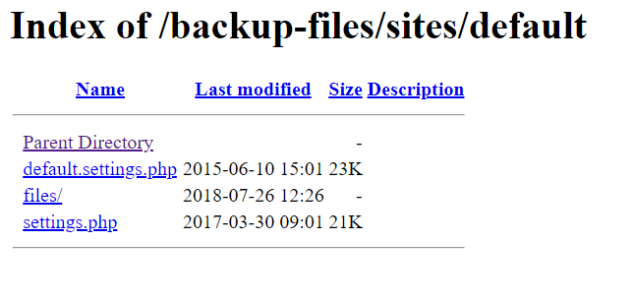
Observation
Navigate to http://hackinglab.internshala.com/backup-files/sites/default/
Complete listing of directory is shown containing names of files and folders of the website

Slide 51
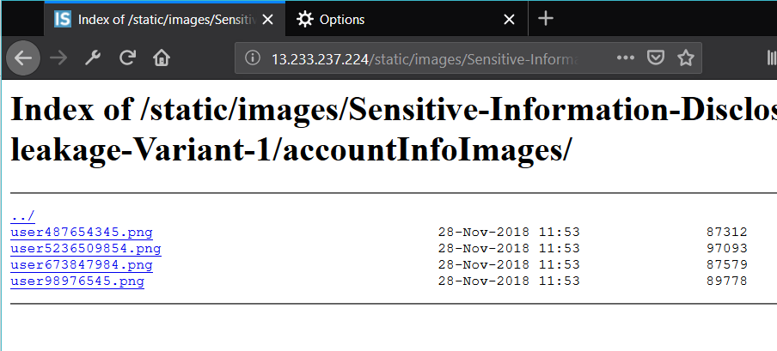
Observation
Navigate to http://hackinglab.internshala.com/static/images/Sensitive-Information-Disclosure/PII-leakage-Variant-1/accountInfoImages/
Complete listing of directory is shown containing profile pictures of all users on the website

Slide 52
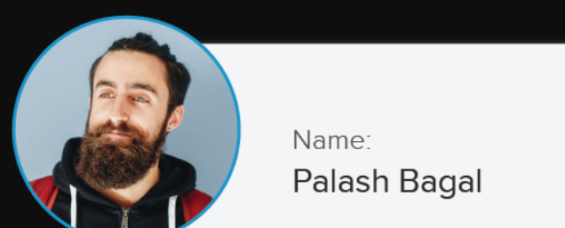
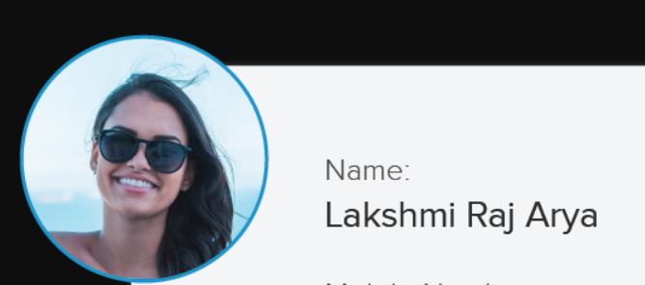
Business Impact – Moderate
Although this vulnerability does not have a direct impact to users or the server, though it can aid the attacker with information about the server and the users
Also, attacker can simply download the backups and images and view them

Slide 53
Recommendation
Take the following precautions:
Disable Directory Listing
Put an index.html in all folders with default message
References:
https://cwe.mitre.org/data/definitions/548.html
https://www.netsparker.com/blog/web-security/disable-directory-listing-web-servers/

Slide 54
7. Information Disclosure
Information Disclosure due to Apache Info Pages (Low) | Below mentioned urls disclose server information Affected URL : http://13.233.237.224/server-status/ http://13.233.237.224/server-info/

Slide 55
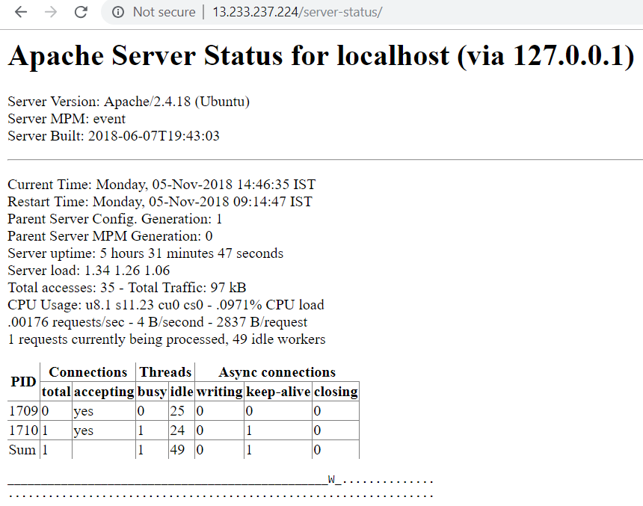
Observation
Navigate to mentioned URL
Default server-status page opens which discloses server information

Slide 56
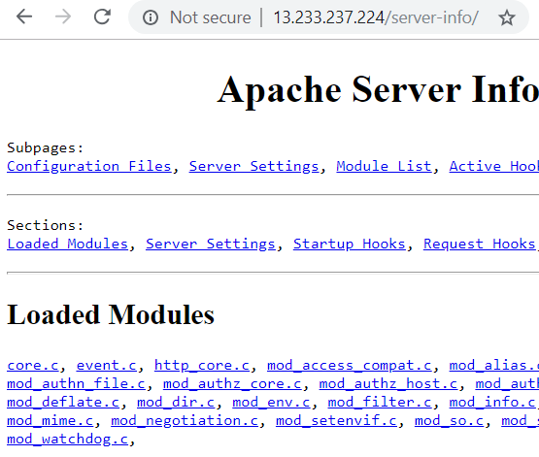
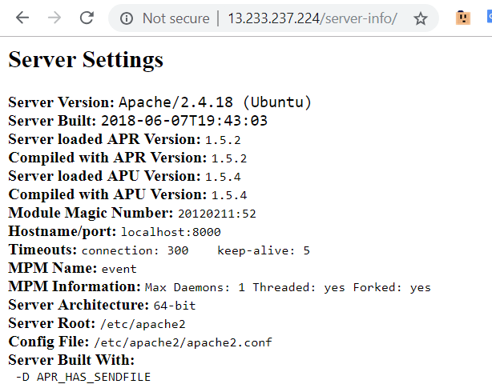
Observation
server-info page

Slide 57
Business Impact – Moderate
Although this vulnerability does not have a direct impact to users or the server, though it can help the attacker in mapping the server architecture and plan further attacks on the server
Recommendation
Take the following precautions:
Disable all default pages and folders including server-status and server-info
References:
https://vuldb.com/?id.88482
https://httpd.apache.org/docs/current/mod/mod_status.html
https://www.beyondsecurity.com/scan_pentest_network_vulnerabilities_apache_http_server_httponly_cookie_information_disclosure

Slide 58
THANK YOU
For any further clarifications/patch assistance, please contact:9075952746

